Slide 1
Cryptography

Slide 2
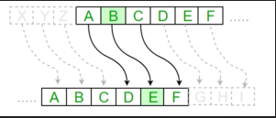
Substitution cipher
A substitution cipher is a type of encryption technique where each letter in the plaintext is replaced with a different letter according to a predetermined substitution key.
Popular example : Caeser cipher

Slide 3
Solve this
GFS WMY OG LGDVS MF SFNKYHOSU ESLLMRS, PC WS BFGW POL DMFRQMRS, PL OG CPFU M UPCCSKSFO HDMPFOSXO GC OIS LMES DMFRQMRS DGFR SFGQRI OG CPDD GFS LISSO GK LG, MFU OISF WS NGQFO OIS GNNQKKSFNSL GC SMNI DSOOSK. WS NMDD OIS EGLO CKSJQSFODY GNNQKKPFR DSOOSK OIS 'CPKLO', OIS FSXO EGLO GNNQKKPFR DSOOSK OIS 'LSNGFU' OIS CGDDGWPFR EGLO GNNQKKPFR DSOOSK OIS 'OIPKU', MFU LG GF, QFOPD WS MNNGQFO CGK MDD OIS UPCCSKSFO DSOOSKL PF OIS HDMPFOSXO LMEHDS. OISF WS DGGB MO OIS NPHISK OSXO WS WMFO OG LGDVS MFU WS MDLG NDMLLPCY POL LYEAGDL. WS CPFU OIS EGLO GNNQKKPFR LYEAGD MFU NIMFRS PO OG OIS CGKE GC OIS 'CPKLO' DSOOSK GC OIS HDMPFOSXO LMEHDS, OIS FSXO EGLO NGEEGF LYEAGD PL NIMFRSU OG OIS CGKE GC OIS 'LSNGFU' DSOOSK, MFU OIS CGDDGWPFR EGLO NGEEGF LYEAGD PL NIMFRSU OG OIS CGKE GC OIS 'OIPKU' DSOOSK, MFU LG GF, QFOPD WS MNNGQFO CGK MDD LYEAGDL GC OIS NKYHOGRKME WS WMFO OG LGDVS
http://p.ip.fi/aZ3A

Slide 4
Brute Force ??
No !!

Slide 5
ETAOIN SHRDLU
Frequency analysis is a common method of breaking substitution ciphers. By analyzing the frequency distribution of letters in the ciphertext, one can make educated guesses about the mapping between plaintext and ciphertext letters.

Slide 7
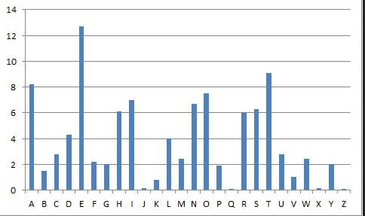
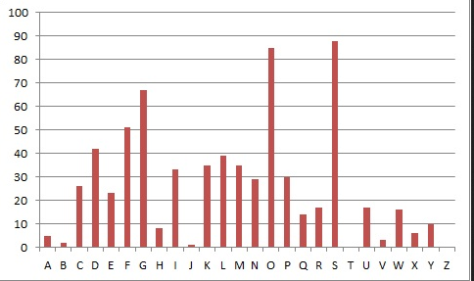

Slide 8
Replacing S,O with e,t
GFe WMY tG LGDVe MF eFNKYHteU EeLLMRe, PC We BFGW PtL DMFRQMRe, PL tG CPFU M UPCCeKeFt HDMPFteXt GC tIe LMEe DMFRQMRe DGFR eFGQRI tG CPDD GFe LIeet GK LG, MFU tIeF We NGQFt tIe GNNQKKeFNeL GC eMNI DetteK. We NMDD tIe EGLt CKeJQeFtDY GNNQKKPFR DetteK tIe 'CPKLt', tIe FeXt EGLt GNNQKKPFR DetteK tIe 'LeNGFU' tIe CGDDGWPFR EGLt GNNQKKPFR DetteK tIe 'tIPKU', MFU LG GF, QFtPD We MNNGQFt CGK MDD tIe UPCCeKeFt DetteKL PF tIe HDMPFteXt LMEHDe. tIeF We DGGB Mt tIe NPHIeK teXt We WMFt tG LGDVe MFU We MDLG NDMLLPCY PtL LYEAGDL. We CPFU tIe EGLt GNNQKKPFR LYEAGD MFU NIMFRe Pt tG tIe CGKE GC tIe 'CPKLt' DetteK GC tIe HDMPFteXt LMEHDe, tIe FeXt EGLt NGEEGF LYEAGD PL NIMFReU tG tIe CGKE GC tIe 'LeNGFU' DetteK, MFU tIe CGDDGWPFR EGLt NGEEGF LYEAGD PL NIMFReU tG tIe CGKE GC tIe 'tIPKU' DetteK, MFU LG GF, QFtPD We MNNGQFt CGK MDD LYEAGDL GC tIe NKYHtGRKME We WMFt tG LGDVe
http://p.ip.fi/aZ3A

Slide 9
tIe -> the
GFe WMY tG LGDVe MF eFNKYHteU EeLLMRe, PC We BFGW PtL DMFRQMRe, PL tG CPFU M UPCCeKeFt HDMPFteXt GC tIe LMEe DMFRQMRe DGFR eFGQRI tG CPDD GFe LIeet GK LG, MFU tIeF We NGQFt tIe GNNQKKeFNeL GC eMNI DetteK. We NMDD tIe EGLt CKeJQeFtDY GNNQKKPFR DetteK tIe 'CPKLt', tIe FeXt EGLt GNNQKKPFR DetteK tIe 'LeNGFU' tIe CGDDGWPFR EGLt GNNQKKPFR DetteK tIe 'tIPKU', MFU LG GF, QFtPD We MNNGQFt CGK MDD tIe UPCCeKeFt DetteKL PF tIe HDMPFteXt LMEHDe. tIeF We DGGB Mt tIe NPHIeK teXt We WMFt tG LGDVe MFU We MDLG NDMLLPCY PtL LYEAGDL. We CPFU tIe EGLt GNNQKKPFR LYEAGD MFU NIMFRe Pt tG tIe CGKE GC tIe 'CPKLt' DetteK GC tIe HDMPFteXt LMEHDe, tIe FeXt EGLt NGEEGF LYEAGD PL NIMFReU tG tIe CGKE GC tIe 'LeNGFU' DetteK, MFU tIe CGDDGWPFR EGLt NGEEGF LYEAGD PL NIMFReU tG tIe CGKE GC tIe 'tIPKU' DetteK, MFU LG GF, QFtPD We MNNGQFt CGK MDD LYEAGDL GC tIe NKYHtGRKME We WMFt tG LGDVe
http://p.ip.fi/aZ3A

Slide 10
tG -> to
GFe WMY tG LGDVe MF eFNKYHteU EeLLMRe, PC We BFGW PtL DMFRQMRe, PL tG CPFU M UPCCeKeFt HDMPFteXt GC the LMEe DMFRQMRe DGFR eFGQRh tG CPDD GFe Lheet GK LG, MFU theF We NGQFt the GNNQKKeFNeL GC eMNh DetteK. We NMDD the EGLt CKeJQeFtDY GNNQKKPFR DetteK the 'CPKLt', the FeXt EGLt GNNQKKPFR DetteK the 'LeNGFU' the CGDDGWPFR EGLt GNNQKKPFR DetteK the 'thPKU', MFU LG GF, QFtPD We MNNGQFt CGK MDD the UPCCeKeFt DetteKL PF the HDMPFteXt LMEHDe. theF We DGGB Mt the NPHheK teXt We WMFt tG LGDVe MFU We MDLG NDMLLPCY PtL LYEAGDL. We CPFU the EGLt GNNQKKPFR LYEAGD MFU NhMFRe Pt tG the CGKE GC the 'CPKLt' DetteK GC the HDMPFteXt LMEHDe, the FeXt EGLt NGEEGF LYEAGD PL NhMFReU tG the CGKE GC the 'LeNGFU' DetteK, MFU the CGDDGWPFR EGLt NGEEGF LYEAGD PL NhMFReU tG the CGKE GC the 'thPKU' DetteK, MFU LG GF, QFtPD We MNNGQFt CGK MDD LYEAGDL GC the NKYHtGRKME We WMFt tG LGDVe
http://p.ip.fi/aZ3A

Slide 11
F -> n L -> s
oFe WMY to LoDVe MF eFNKYHteU EeLLMRe, PC We BFoW PtL DMFRQMRe, PL to CPFU M UPCCeKeFt HDMPFteXt oC the LMEe DMFRQMRe DoFR eFoQRh to CPDD oFe Lheet oK Lo, MFU theF We NoQFt the oNNQKKeFNeL oC eMNh DetteK. We NMDD the EoLt CKeJQeFtDY oNNQKKPFR DetteK the 'CPKLt', the FeXt EoLt oNNQKKPFR DetteK the 'LeNoFU' the CoDDoWPFR EoLt oNNQKKPFR DetteK the 'thPKU', MFU Lo oF, QFtPD We MNNoQFt CoK MDD the UPCCeKeFt DetteKL PF the HDMPFteXt LMEHDe. theF We DooB Mt the NPHheK teXt We WMFt to LoDVe MFU We MDLo NDMLLPCY PtL LYEAoDL. We CPFU the EoLt oNNQKKPFR LYEAoD MFU NhMFRe Pt to the CoKE oC the 'CPKLt' DetteK oC the HDMPFteXt LMEHDe, the FeXt EoLt NoEEoF LYEAoD PL NhMFReU to the CoKE oC the 'LeNoFU' DetteK, MFU the CoDDoWPFR EoLt NoEEoF LYEAoD PL NhMFReU to the CoKE oC the 'thPKU' DetteK, MFU Lo oF, QFtPD We MNNoQFt CoK MDD LYEAoDL oC the NKYHtoRKME We WMFt to LoDVe
http://p.ip.fi/aZ3A

Slide 12
soDVe -> solve oK -> or
one WMY to soDVe Mn enNKYHteU EessMRe, PC We BnoW Pts DMnRQMRe, Ps to CPnU M UPCCeKent HDMPnteXt oC the sMEe DMnRQMRe DonR enoQRh to CPDD one sheet oK so, MnU then We NoQnt the oNNQKKenNes oC eMNh DetteK. We NMDD the Eost CKeJQentDY oNNQKKPnR DetteK the 'CPKst', the neXt Eost oNNQKKPnR DetteK the 'seNonU' the CoDDoWPnR Eost oNNQKKPnR DetteK the 'thPKU', MnU so on, QntPD We MNNoQnt CoK MDD the UPCCeKent DetteKs Pn the HDMPnteXt sMEHDe. then We DooB Mt the NPHheK teXt We WMnt to soDVe MnU We MDso NDMssPCY Pts sYEAoDs. We CPnU the Eost oNNQKKPnR sYEAoD MnU NhMnRe Pt to the CoKE oC the 'CPKst' DetteK oC the HDMPnteXt sMEHDe, the neXt Eost NoEEon sYEAoD Ps NhMnReU to the CoKE oC the 'seNonU' DetteK, MnU the CoDDoWPnR Eost NoEEon sYEAoD Ps NhMnReU to the CoKE oC the 'thPKU' DetteK, MnU so on, QntPD We MNNoQnt CoK MDD sYEAoDs oC the NKYHtoRKME We WMnt to soDVe
http://p.ip.fi/aZ3A

Slide 13
enoQRh -> enough
one WMY to solve Mn enNrYHteU EessMRe, PC We BnoW Pts lMnRQMRe, Ps to CPnU M UPCCerent HlMPnteXt oC the sMEe lMnRQMRe lonR enoQRh to CPll one sheet or so, MnU then We NoQnt the oNNQrrenNes oC eMNh letter. We NMll the Eost CreJQentlY oNNQrrPnR letter the 'CPrst', the neXt Eost oNNQrrPnR letter the 'seNonU' the ColloWPnR Eost oNNQrrPnR letter the 'thPrU', MnU so on, QntPl We MNNoQnt Cor Mll the UPCCerent letters Pn the HlMPnteXt sMEHle. then We looB Mt the NPHher teXt We WMnt to solve MnU We Mlso NlMssPCY Pts sYEAols. We CPnU the Eost oNNQrrPnR sYEAol MnU NhMnRe Pt to the CorE oC the 'CPrst' letter oC the HlMPnteXt sMEHle, the neXt Eost NoEEon sYEAol Ps NhMnReU to the CorE oC the 'seNonU' letter, MnU the ColloWPnR Eost NoEEon sYEAol Ps NhMnReU to the CorE oC the 'thPrU' letter, MnU so on, QntPl We MNNoQnt Cor Mll sYEAols oC the NrYHtoRrME We WMnt to solve
http://p.ip.fi/aZ3A

Slide 14
enNrYHteU -> encrypted EessMge -> Message
one WMY to solve Mn enNrYHteU EessMge, PC We BnoW Pts lMnguMge, Ps to CPnU M UPCCerent HlMPnteXt oC the sMEe lMnguMge long enough to CPll one sheet or so, MnU then We Nount the oNNurrenNes oC eMNh letter. We NMll the Eost CreJuentlY oNNurrPng letter the 'CPrst', the neXt Eost oNNurrPng letter the 'seNonU' the ColloWPng Eost oNNurrPng letter the 'thPrU', MnU so on, untPl We MNNount Cor Mll the UPCCerent letters Pn the HlMPnteXt sMEHle. then We looB Mt the NPHher teXt We WMnt to solve MnU We Mlso NlMssPCY Pts sYEAols. We CPnU the Eost oNNurrPng sYEAol MnU NhMnge Pt to the CorE oC the 'CPrst' letter oC the HlMPnteXt sMEHle, the neXt Eost NoEEon sYEAol Ps NhMngeU to the CorE oC the 'seNonU' letter, MnU the ColloWPng Eost NoEEon sYEAol Ps NhMngeU to the CorE oC the 'thPrU' letter, MnU so on, untPl We MNNount Cor Mll sYEAols oC the NrYHtogrME We WMnt to solve
http://p.ip.fi/aZ3A

Slide 15
Way -> way Bnow->know Pts->its
one Way to solve an encrypted message, PC We BnoW Pts language, Ps to CPnd a dPCCerent plaPnteXt oC the same language long enough to CPll one sheet or so, and then We count the occurrences oC each letter. We call the most CreJuently occurrPng letter the 'CPrst', the neXt most occurrPng letter the 'second' the ColloWPng most occurrPng letter the 'thPrd', and so on, untPl We account Cor all the dPCCerent letters Pn the plaPnteXt sample. then We looB at the cPpher teXt We Want to solve and We also classPCy Pts symAols. We CPnd the most occurrPng symAol and change Pt to the Corm oC the 'CPrst' letter oC the plaPnteXt sample, the neXt most common symAol Ps changed to the Corm oC the 'second' letter, and the ColloWPng most common symAol Ps changed to the Corm oC the 'thPrd' letter, and so on, untPl We account Cor all symAols oC the cryptogram We Want to solve
http://p.ip.fi/aZ3A

Slide 16
C->f X->x J->q A->b
one way to solve an encrypted message, iC we know its language, is to Cind a diCCerent plainteXt oC the same language long enough to Cill one sheet or so, and then we count the occurrences oC each letter. we call the most CreJuently occurring letter the 'Cirst', the neXt most occurring letter the 'second' the Collowing most occurring letter the 'third', and so on, until we account Cor all the diCCerent letters in the plainteXt sample. then we look at the cipher teXt we want to solve and we also classiCy its symAols. we Cind the most occurring symAol and change it to the Corm oC the 'Cirst' letter oC the plainteXt sample, the neXt most common symAol is changed to the Corm oC the 'second' letter, and the Collowing most common symAol is changed to the Corm oC the 'third' letter, and so on, until we account Cor all symAols oC the cryptogram we want to solve
http://p.ip.fi/aZ3A

Slide 17
Solved
one way to solve an encrypted message, if we know its language, is to find a different plaintext of the same language long enough to fill one sheet or so, and then we count the occurrences of each letter. we call the most frequently occurring letter the 'first', the next most occurring letter the 'second' the following most occurring letter the 'third', and so on, until we account for all the different letters in the plaintext sample. then we look at the cipher text we want to solve and we also classify its symbols. we find the most occurring symbol and change it to the form of the 'first' letter of the plaintext sample, the next most common symbol is changed to the form of the 'second' letter, and the following most common symbol is changed to the form of the 'third' letter, and so on, until we account for all symbols of the cryptogram we want to solve
http://p.ip.fi/aZ3A

Slide 18
Single Byte XOR
The Single-Byte XOR cipher is a method of cryptography where each byte of data in the plaintext is combined with a single byte key using the XOR operation.

Slide 19
Can we make this stronger??

Slide 20
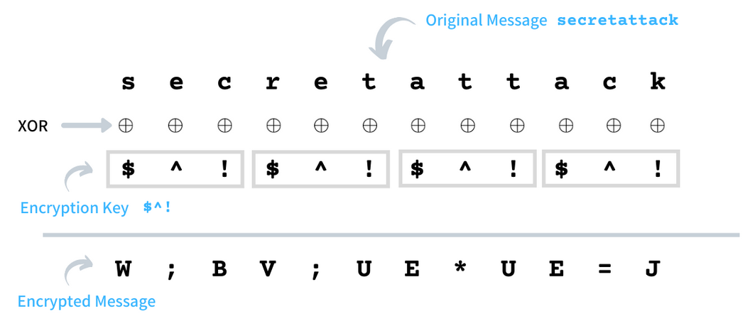
Repeating key XOR
Example :

Slide 21
How to break it??
If you know the key size to be k, then we could divide text into k parts with each part consisting of bytes that are k positions apart, such as the 1st byte, (k+1)th byte, (2k+1)th byte, and so on.. To decrypt, the same method as the Single-Byte XOR cipher is applied to each part

Slide 22
Given that you don't know key size, is it unbreakable??

Slide 23
No, it is breakable as well
The average Hamming distance between any two bytes [0-256) picked at random is 3.9999 while that of any two lowercased English characters [97, 122] is just 2.45.
Similar ratios are observed for Hamming Score where 0.4999 is of the former while 0.3072 is of the later.
Hamming score is essentially the probability that 2 bits at corresponding position is 1.

Slide 24
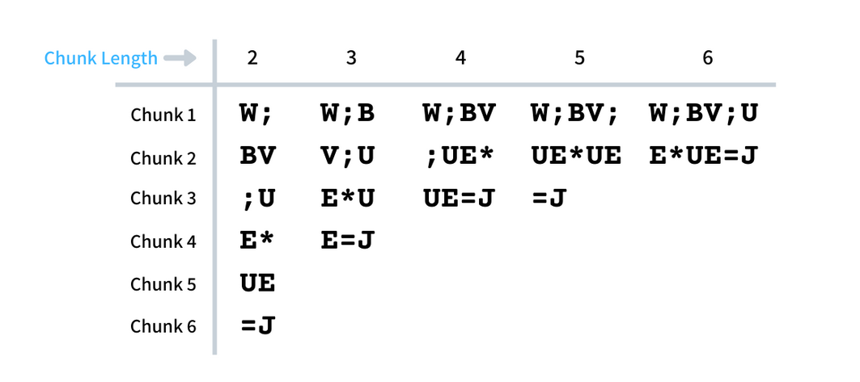
We first chunk ciphertext into chunks of key sizes

Slide 25
Then for all chunk sizes, find the hamming average hamming distance between 2 chunks, this is divided by number of bytes to give hamming score
The chunk size with least hamming score is mostly the key size.

Slide 26
Why this works??

Slide 27
For our example the graph looks this way

Slide 29
Question for you
http://p.ip.fi/1kjf

Slide 30
Can't we make it unbreakable??

Slide 31
One Time Pad

Slide 32
Thank you !!!

