Slide 1
ext:pdf intext:”What is OSINT?”
A quick intro to the world of Open Source Intelligence
-By Anirudh V

Slide 2
What is OSINT?
OSINT - Open Source Intelligence
Involves gathering publicly available information.
Procuring verbal, written, or electronic material that can be obtained legally.
Processing this information to get meaningful information.
Analyzing the gathered information and making meaningful conclusions.

Slide 3
But… Why?

Slide 4
OSINT Can Help In Locating Criminals
Source: https://www.bellingcat.com/news/2022/11/29/us-american-white-supremacist-facing-criminal-charges-located-in-bulgaria/

Slide 5
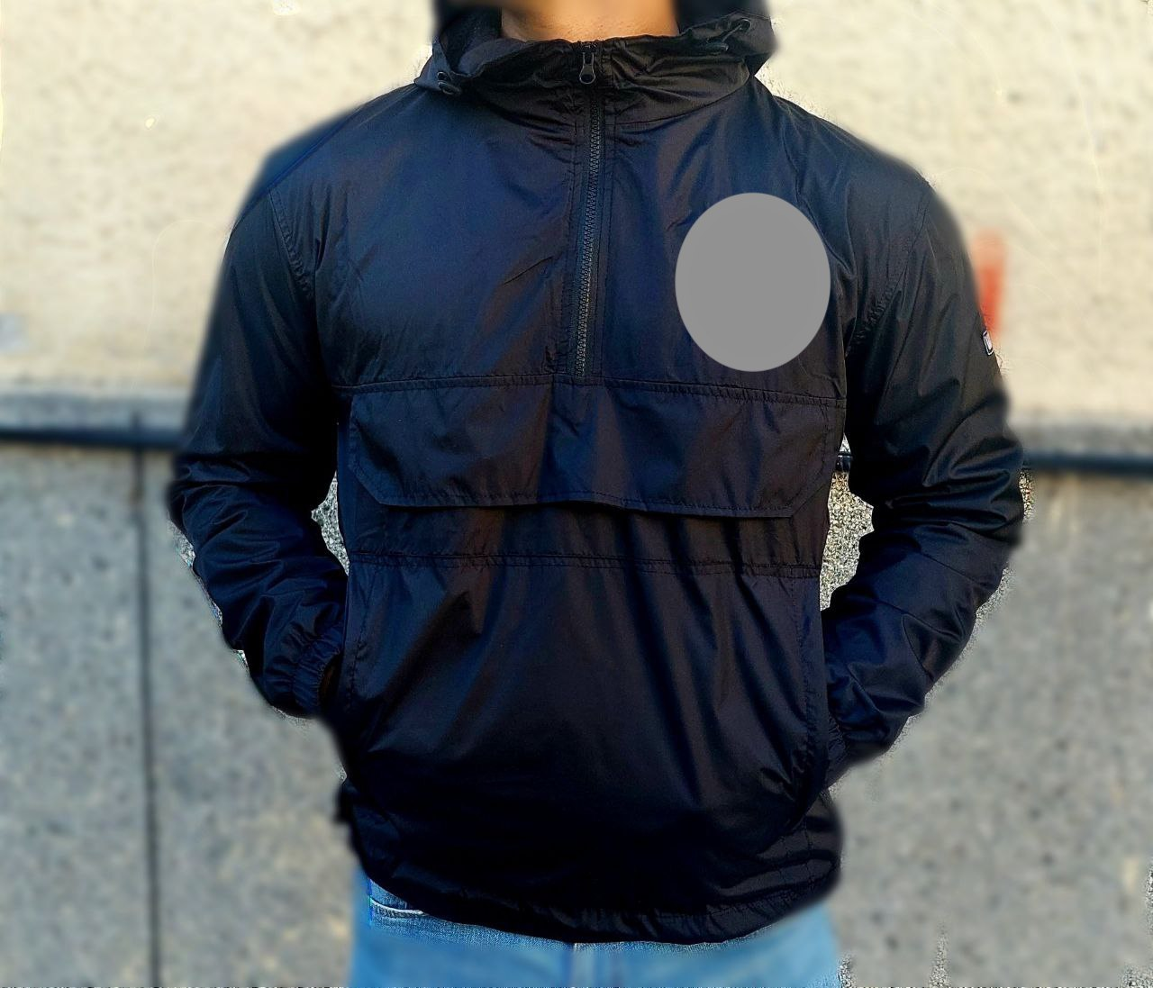

Slide 6
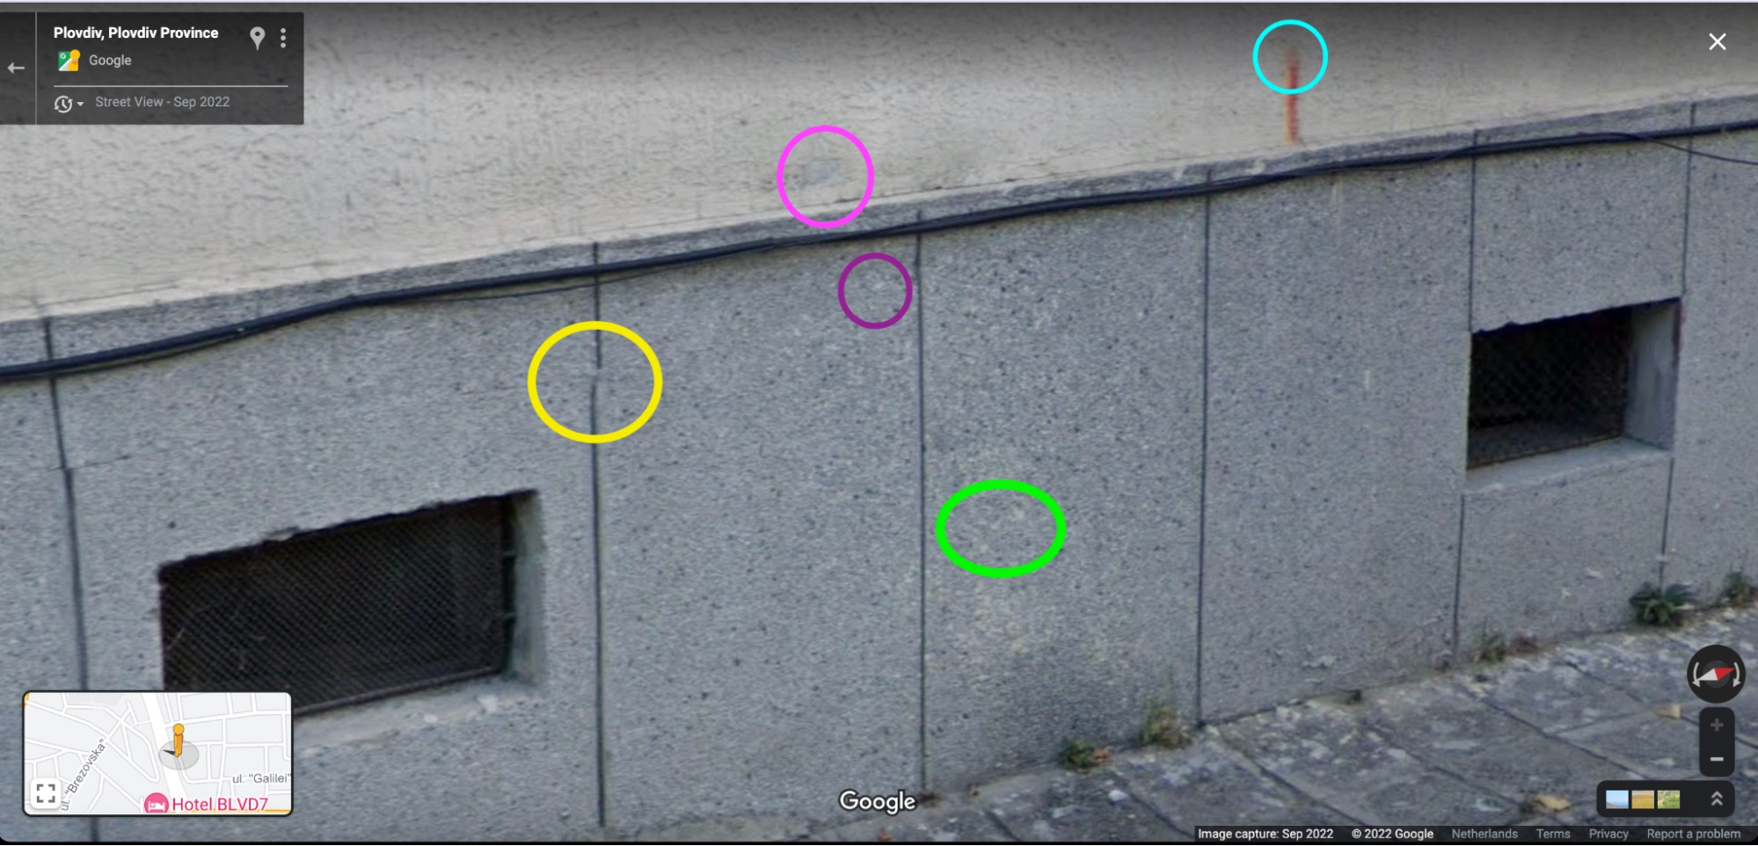

Slide 7
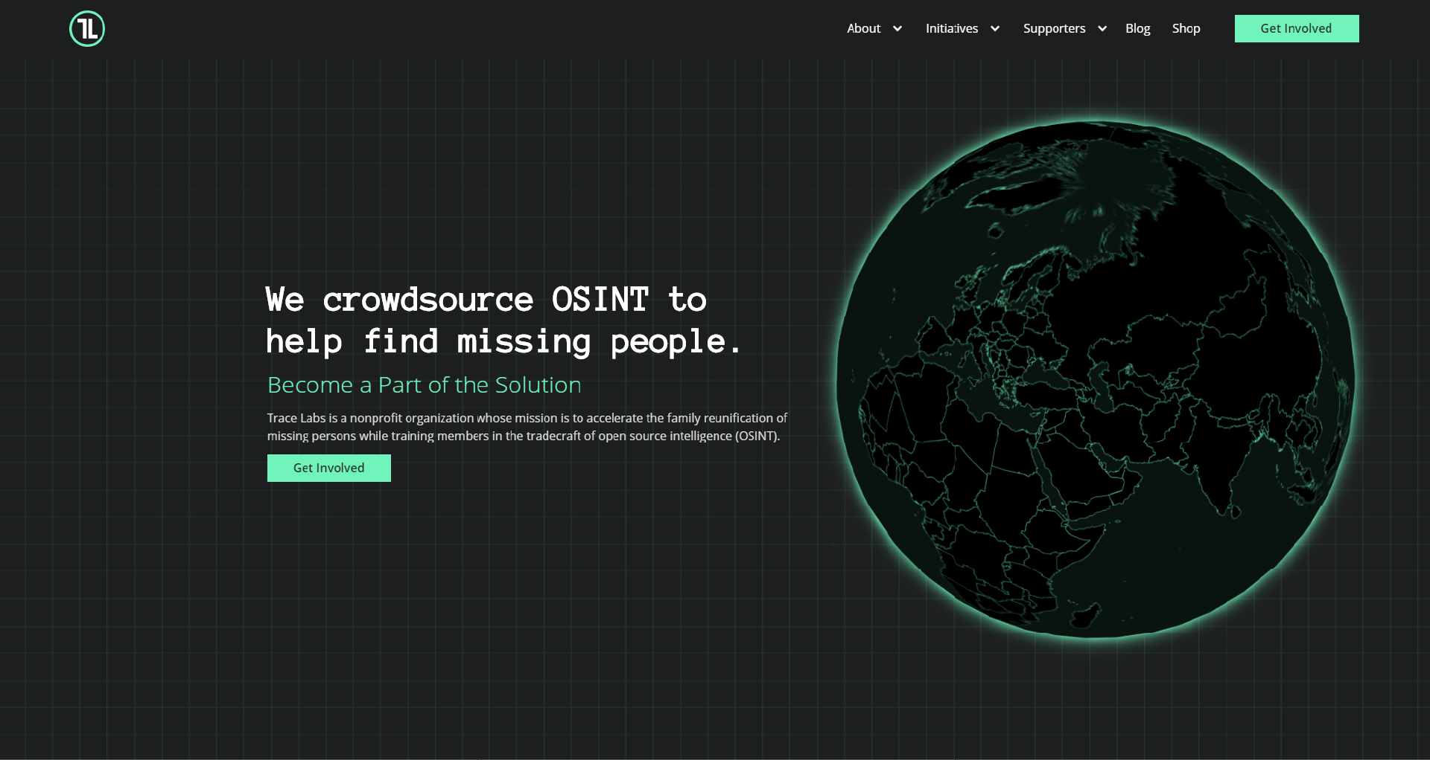
OSINT Can Help Find Missing People
https://www.sans.org/press/announcements/hackers-join-forces-to-help-law-enforcement-agencies-solve-real-missing-persons-cases/

Slide 8
OSINT can help you understand how public info about you
really is!

Slide 9
An Example
Lets see what we can find out about me!
Hmmm, doesn’t seem like we found anything :(

Slide 10
An Example
Let’s make the search more specific…
(Google Dorks)
We found something!

Slide 11
An Example
Can we perhaps use what we found?
That’s a lot of info!

Slide 12
So… How?
Google is your best friend
See 1.
Github - https://github.com/jivoi/awesome-osint

Slide 13
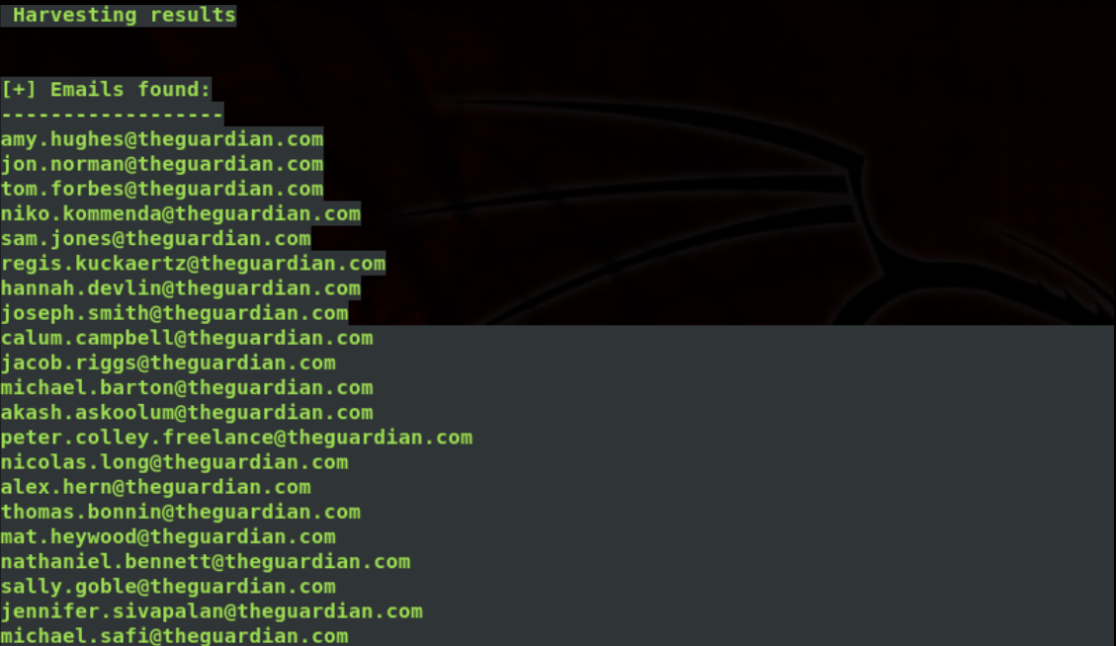
An Example - OSINT On Organizations
Using theHarvester
(https://github.com/laramies/theHarvester)
Finding emails
(Web Scraping)

Slide 14
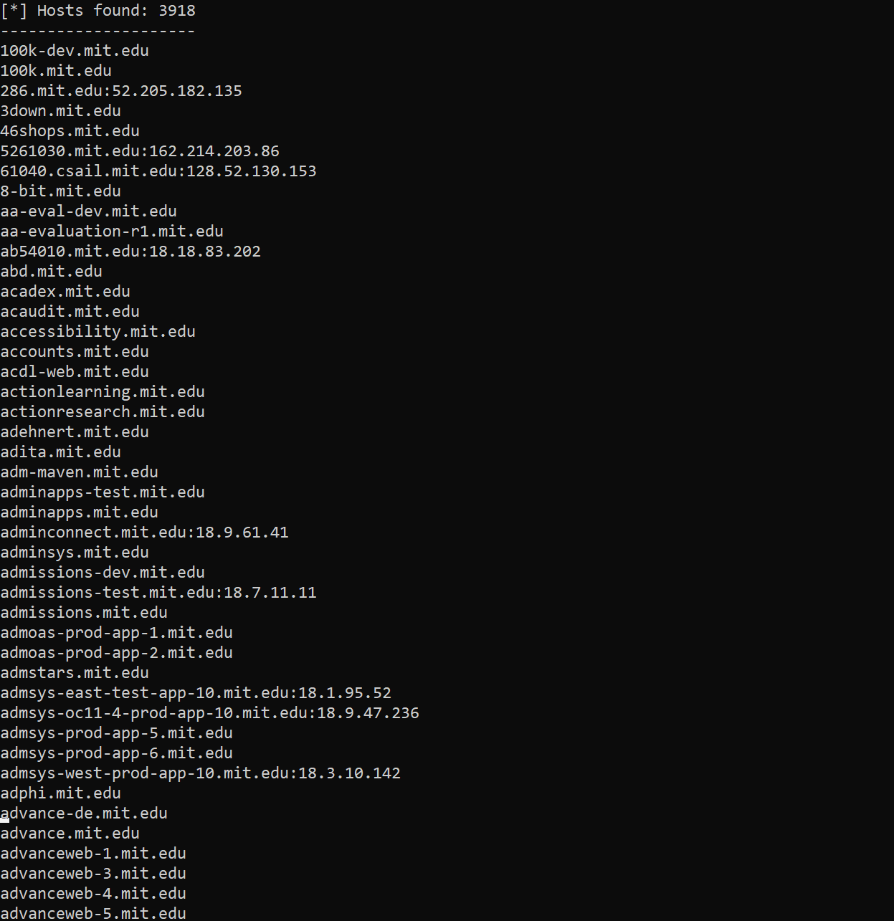
An Example - OSINT On Organizations
Subdomain Enumeration
Using

Slide 15
Some Resources
Google!
https://www.youtube.com/@OSINTCurious - Amazing podcast and videos
https://inteltechniques.com/index.html - Great blog posts and great book
https://www.bellingcat.com/ - Some of the best real world OSINT work out there

Slide 16
Questions For Me?

Slide 17
Questions For You!

Slide 18
Question 1
What is my roll number?
(IIITH format - yyyyxxxxxx, where yyyy is the year of admission and xxxxxx identifies branch and roll no.)

Slide 19
Solution

Slide 20
Question 2
Which city was I in on the 5th Saturday of July 2011?
(Give me coordinates!)
(Hint - Use my name and use Google Dorks to refine the search results)

Slide 21
Solution

Slide 22
Solution

